Slide 1
Cooking with AWS and Splunk
Overview Module
Kam Amir | Splunk Cloud Architect

Slide 2
Cooking Class Overview
Pre-Work
Workshop
Getting Started with AWS
AWS Account
APN Account
Configure AWS
IAM Policy / Roles
AWS Config
Setup Infrastructure / Splunk
Manual Build vs. CloudFormation Template
Setup Splunk App for AWS
AWS Cloudtrail
AWS CloudWatch
Troubleshoot App
Modular Inputs
VPCFlow Logs
Search _internal
Validate Permissions
Check Inputs
AWS Services Explained
Manual Setup Steps
CloudFormation Template
AWS Market Place Splunk AMI
AWS Config
AWS CloudTrail
Lambda / HEC
AWS CloudWatch
Saved Searches, Macros, DMA
Migrating AWS TA between machines
Move Accounts, inputs from SH to HWF
Kinesis Firehose
Setup Policy
Setup Permission
Configure Streams
Splunk Requirements

Slide 3

Purpose
AWS Field Enablement
Splunk App for AWS Enablement
Troubleshooting Splunk and App for AWS
Intended for Technical Field Members (Partners, Support, SE’s, SME’s, CSM etc.)
Formal Process for Supporting Splunk in AWS and the associated Splunk App for AWS
Notes:
The purpose for this course is to help the field understand the components found in AWS and how they are relevant to Splunk and the customer. This course assumes you have some basic Splunk knowledge and how to install the product along with basic Linux / sysadmin skills. The accompanying modules will walk you through the entire lifecycle of creating an AWS account to having a working Splunk instance with the App fully functioning.

Slide 4
Getting an AWS Account
Follow these steps to obtain a Splunk Sponsored AWS Account (Splunk Employees only)

Slide 5
New AWS Account Request
https://confluence.splunk.com/display/SD/Requesting+AWS+Accounts
ServiceNow Request Account
Give AWS Account details
Estimate Budget (<$100 typically)
Permissions for AWS Account (Admin for SE's)
SE Name for Account
New
Account
Open ServiceNow ticket
Report An Issue
Category – Software Business Application
Subcategory – AWS
Watchers – Sean Jacobs
Short Description – Request New AWS Account
Description – “This new AWS account is for <Your_Name>, <Role>, <Region> to be used for testing and learning how Splunk and AWS integrate. I will need Admin permission to my account. The Estimate Budget will be under $100 a month. The account name should be <Your_AD_Login>.”
Notes:
Please follow these steps to formally add your AWS account to the Splunk master account.

Slide 6
Transfer Existing AWS Account to Splunk
https://confluence.splunk.com/display/SD/Transferring+Payment+and+Ownership+of+an+AWS+Account+to+Splunk
ServiceNow Transfer AWS Account
AWS Account Name
Estimate Budget (<$100 typically)
Account Transfer Process
Permission Level Requested (Admin for SE's)
Upload Key Transfer to box folder
Transfer
Account
Open ServiceNow ticket
Report An Issue
Category – Software Business Application
Subcategory – AWS
Short Description – Request New AWS Account
Watchers – Sean Jacobs
Description – “This is an AWS account transfer for <Your_Name>, <Role>, <Region> to be used for testing and learning how Splunk and AWS integrate. I will need Admin permission to my account. The Estimate Budget will be under $100 a month. The account name should be <Your_AD_Login>. I have successfully uploaded my AWS Data to the AWS Key Transfer box.”
Text File with your information below posted to this box folder: “AWS Key Transfer” 1) Email for AWS Login <your_AD_user>@splunk.com
2) Password
3) AWS Account #
4) Disable MFA for Root Account
Notes:
Once these steps have been complete, you will be able to deploy EC2 instances and not have to expense your use on AWS.

Slide 7
Getting your AWS Account 1 of 2
Follow these new steps for setting up your AWS account with Splunk
In the future please follow the correct procedure for opening an AWS account here: Requesting AWS Accounts
Do not open AWS accounts on your own. Splunk IP may only be hosted on a Splunk managed AWS account.
OK. That being said, you have an AWS Account you need to transfer to Splunk:
Open a ticket in Service Now
Short Description:
Transfer AWS Account to Splunk
Details to Include:
Will this account be for a single user or a group/team?
List team members to have access and their access levels
Estimated Budget - https://calculator.s3.amazonaws.com/index.html
Requested account name
Notes:
Please follow these steps to formally add your AWS account to the Splunk master account.

Slide 8
Getting your AWS Account 2 of 2
Follow these new steps for setting up your AWS account with Splunk
Determine what access level each user will need (for detailed level descriptions see below)
Permission Levels are Admin (access to IAM etc.), Power User (spin up EC2 and perform most AWS tasks), Billing (read only w/ visibility of costs for Accounting/Finance), or User (read only access)
Account Transfer Process:
You will need to provide your current account details. A secure folder will be shared to you in Box called AWS Key Transfer. You must upload a text file to the shared folder that includes:
Email address used to login to the AWS account
Password
Account #
Did you enable multi-factor authentication? Are you required to enter a one time number code to login to the account? Please note in your text file if you do.
Your account will be merged with the Splunk organization account.
An Okta chiclet associated with the account will be added to all requested user's Okta Dashboards.
The root password will be reset. If you have a specific reason for root access please include those details in the ServiceNow request. (This is the account used to access the Console.)
Notes:
Once these steps have been complete, you will be able to deploy EC2 instances and not have to expense your use on AWS.

Slide 9
Signing up for Amazon Partner Network (APN)

Slide 10
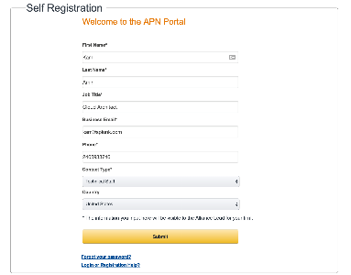
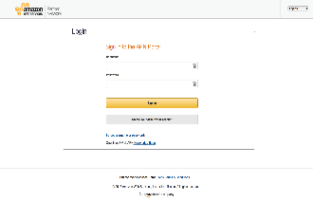
Step 2 – Sign up for the Partner Portal
Go to https://aws.amazon.com/partners
A valid Splunk.com email account
An AWS Account
Required for Partner Portal
Notes:
For additional resources, please join the Amazon Partner Network. This free service will give you access to online learning and discounts to in-person classes.

Slide 11
Optionally setting up GovCloud AWS Account

Slide 12
Optional - GovCloud
AWS GovCloud (US) is an isolated AWS region designed to host sensitive data and regulated workloads in the cloud, helping customers support their U.S. government compliance requirements, including the International Traffic in Arms Regulations (ITAR) and Federal Risk and Authorization Management Program (FedRAMP). AWS GovCloud (US) is operated by employees who are vetted "U.S. Persons" and root account holders of AWS accounts must confirm they are U.S. Persons before being granted access credentials to the region.
AWS GovCloud (US) is available to U.S. government agencies and organizations in government-regulated industries, that meet GovCloud (US) requirements for access.
Notes:
Optionally, you can sign up for a GovCloud account. This is only allowed for US Citizens and must be approved by HR. Please contact HR directly if you plan on obtaining a GovCloud Account.

Slide 13
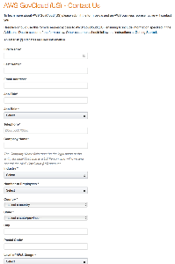
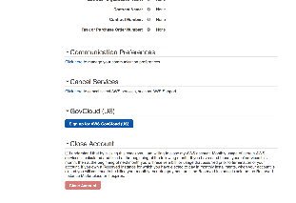
Sign up for GovCloud
Go to https://aws.amazon.com/govcloud-us/getting-started/
US Citizenship
Approval from Splunk HR
**US Citizens Only**
Notes:
Please go to https://aws.amazon.com/govcloud-us/getting-started/ to get started in the process to get access to GovCloud.

Slide 14
Continue to Module 1: Getting Started with AWS

